Slide 1
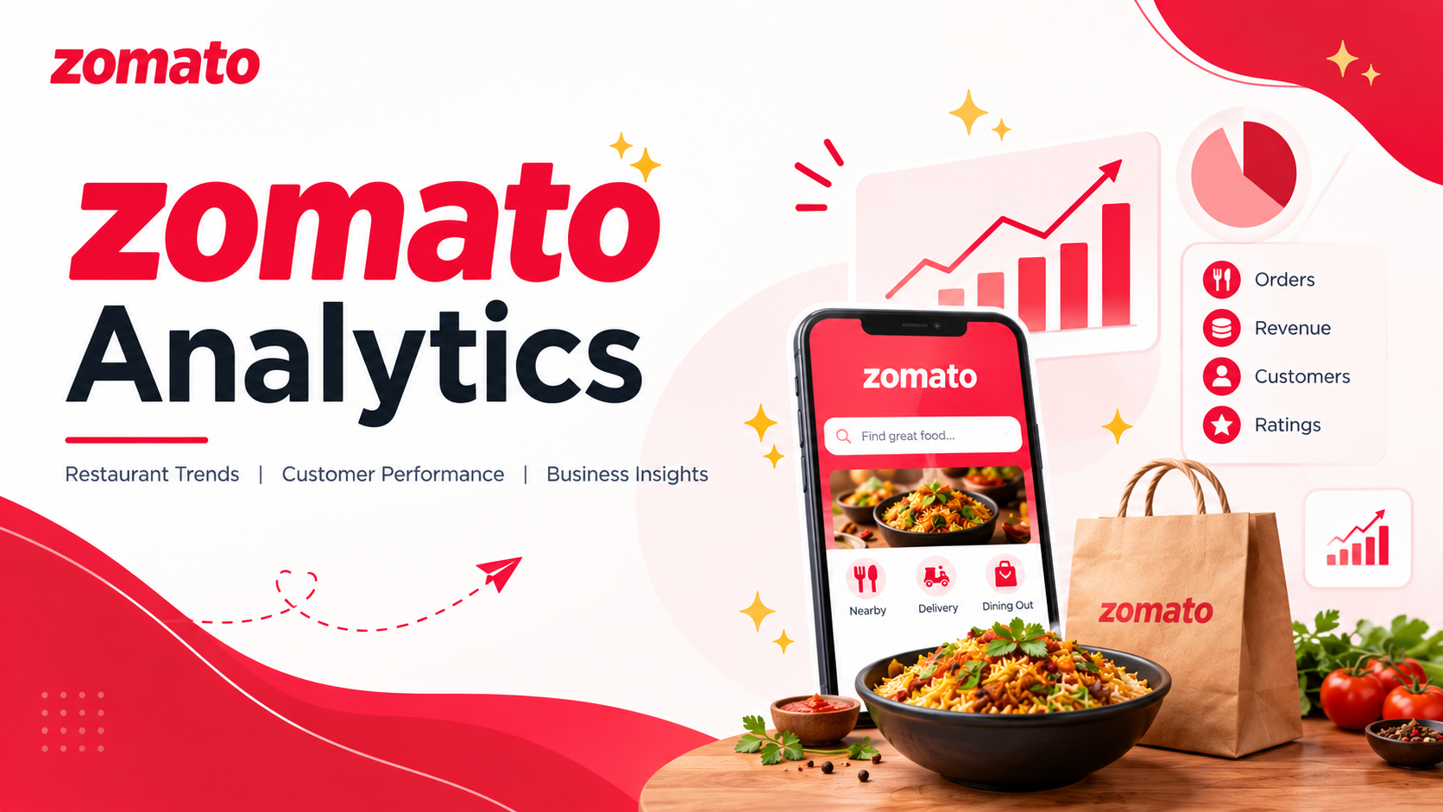

Slide 2

Kasturi Umesh Dhonde
Khushi Sanjay Sonawane
Uzma Tarannum
Shalini Panda
Mogudumpally Srikar
Sanka Doli Naga Sai Anantha Kowshik

Slide 3
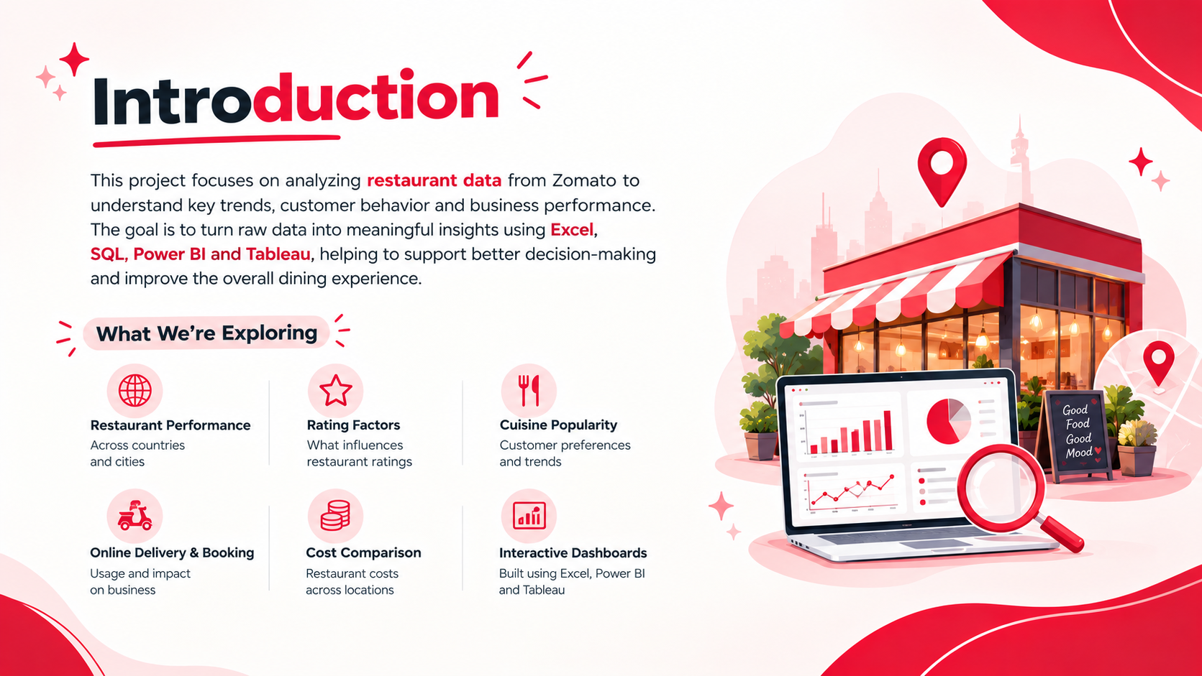

Slide 4

Project Summary / Objective
Analyse restaurant performance across countries and cities.
Identify factors affecting restaurant ratings.
Study cuisine popularity and customer preferences.
Analyze online delivery and table booking services.
Compare restaurant costs across locations.
Create interactive dashboards using Excel, Power BI, and Tableau.

Slide 5

KPI`s
KPI List
KPI | Formula
Total Restaurants | COUNT(Restaurant ID)
Total Votes | SUM(Votes)
Average Rating | AVG(Rating)
Average Cost for Two | AVG(Average Cost for Two)
Total Countries | COUNT(DISTINCT Country)
Online Delivery % | Restaurants with Delivery / Total Restaurants
Table Booking % | Restaurants with Booking / Total Restaurants
Top Cuisines | Based on Restaurant Count
Top Cities | Based on Restaurant Count

Slide 6
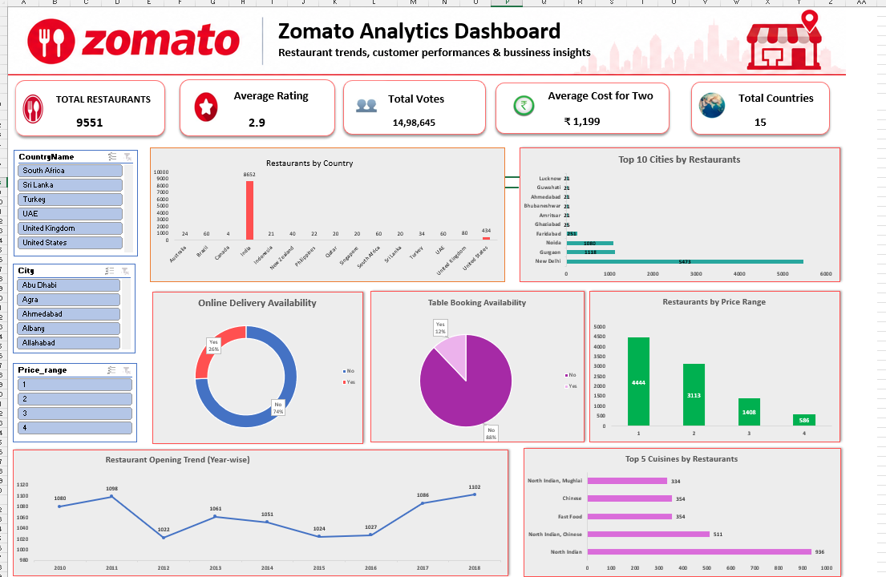
Excel Dashboard

Slide 7

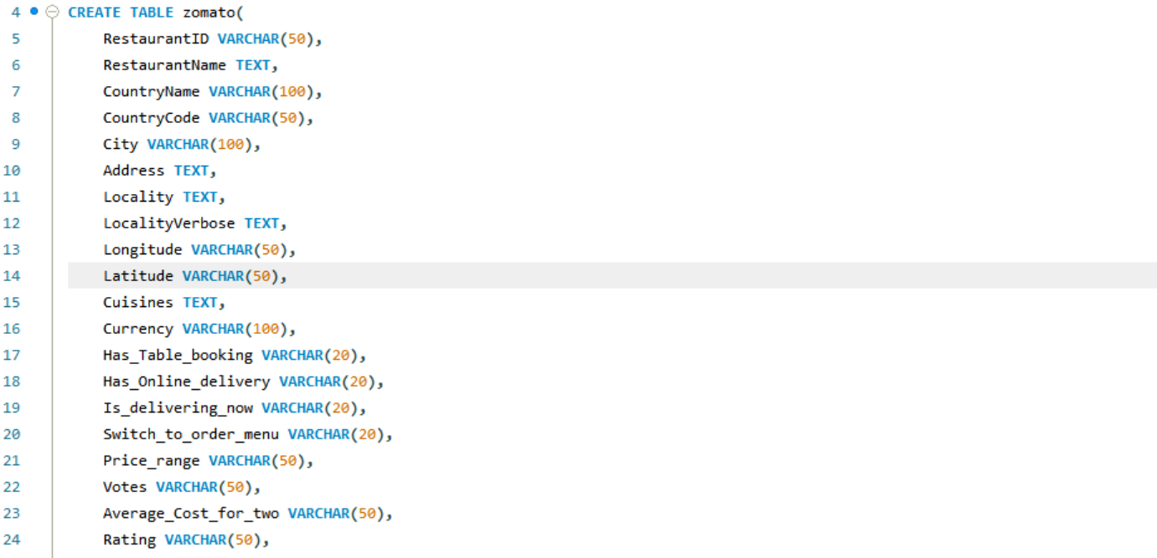
SQL

Slide 8
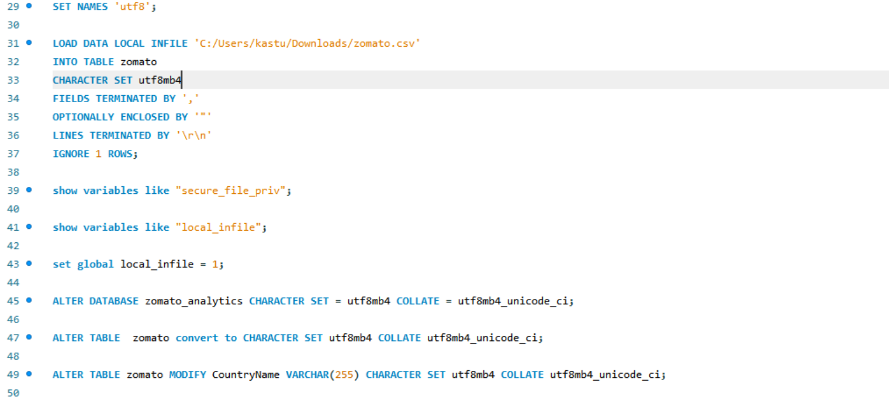

SQL

Slide 9
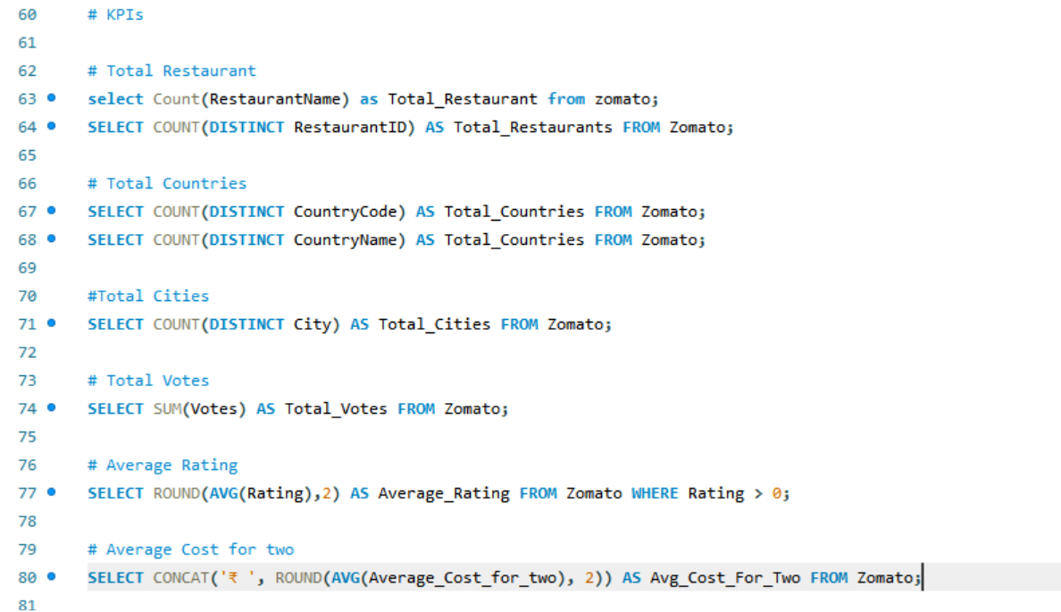
SQL

Slide 10
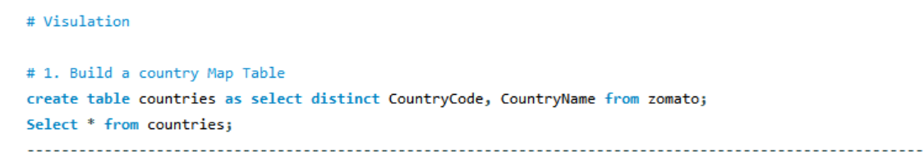
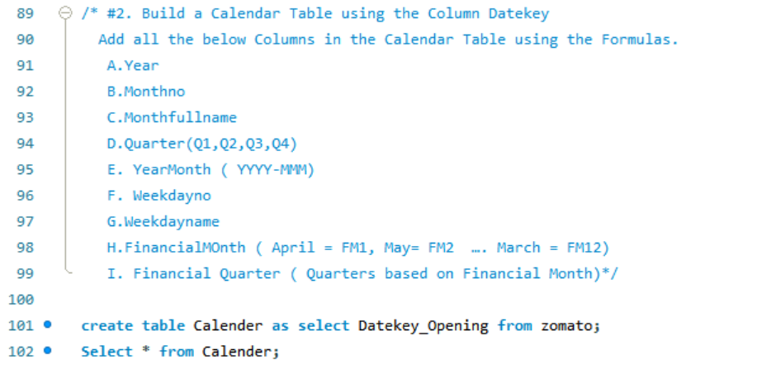
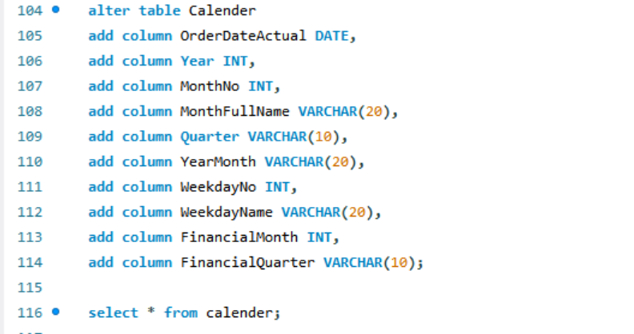
SQL

Slide 11
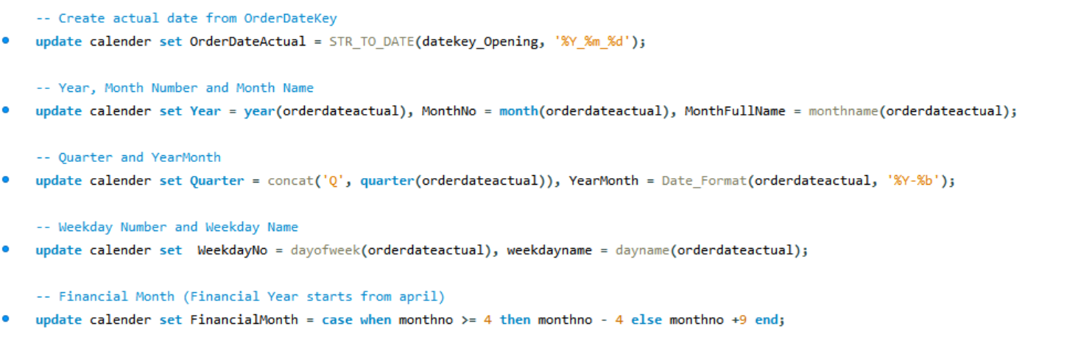
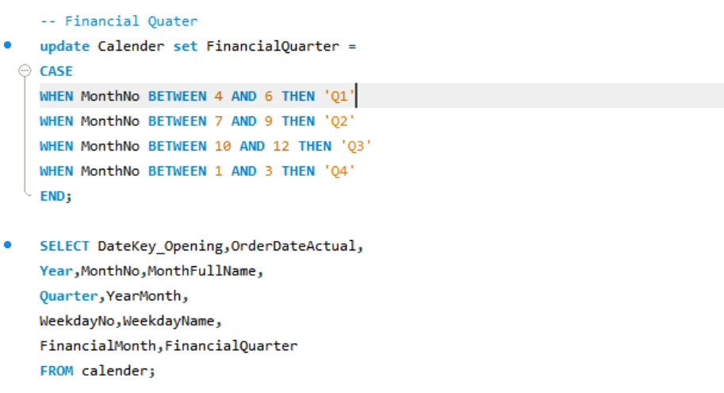
SQL

Slide 12
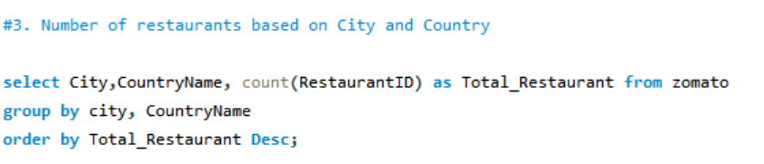
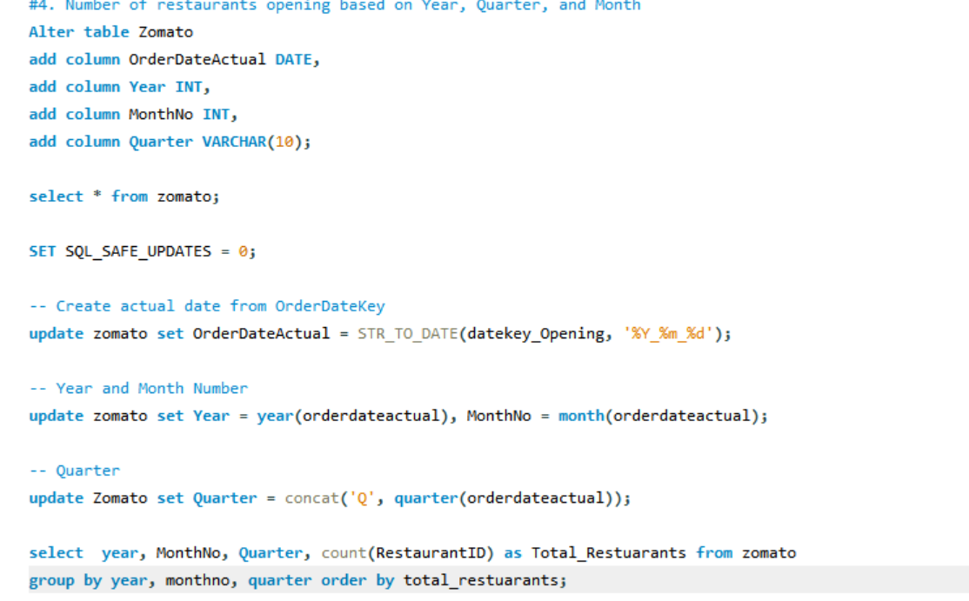
SQL

Slide 13
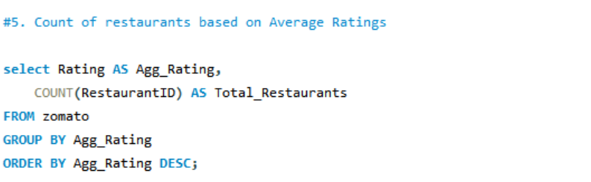
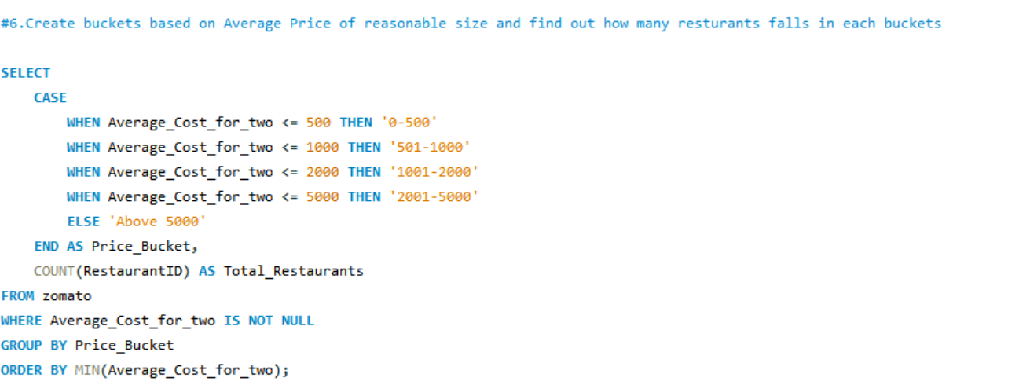
SQL

Slide 14
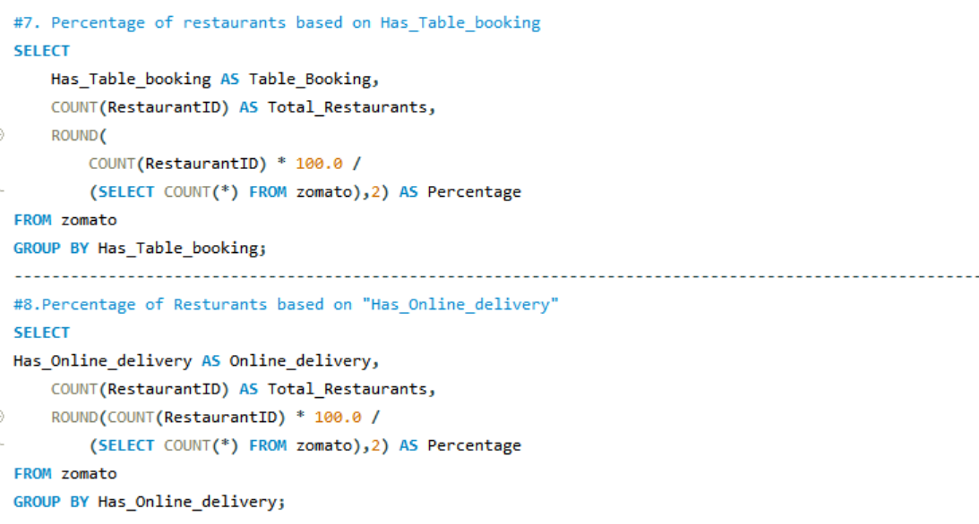
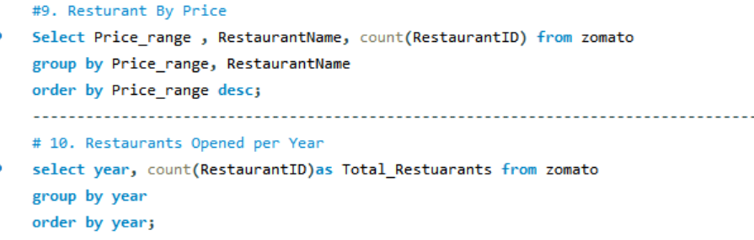
SQL

Slide 15
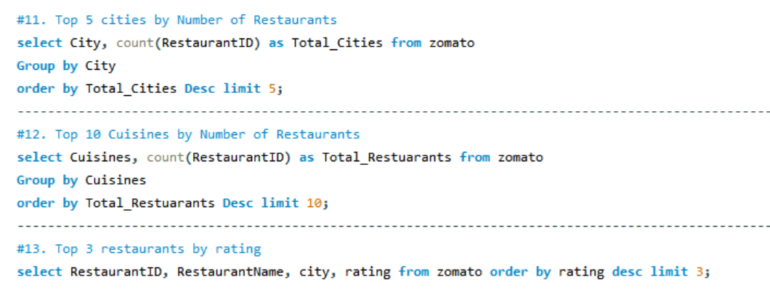
SQL

Slide 16
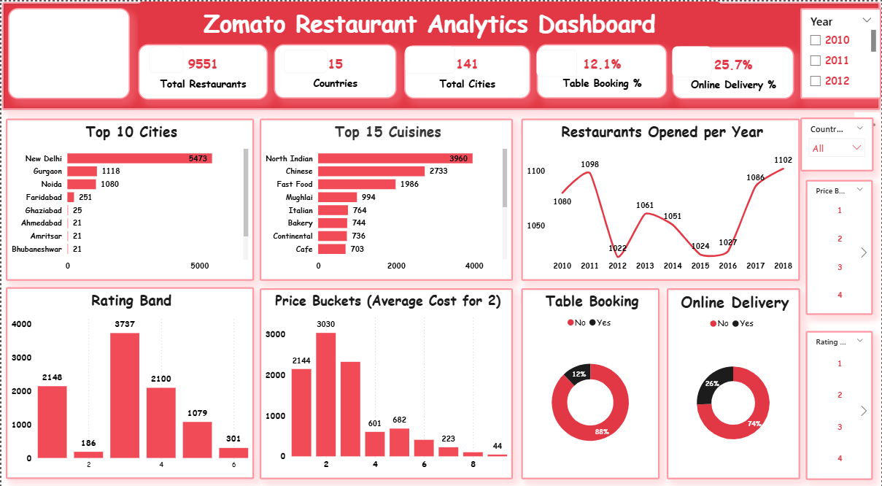
Power BI Dashboard

Slide 17
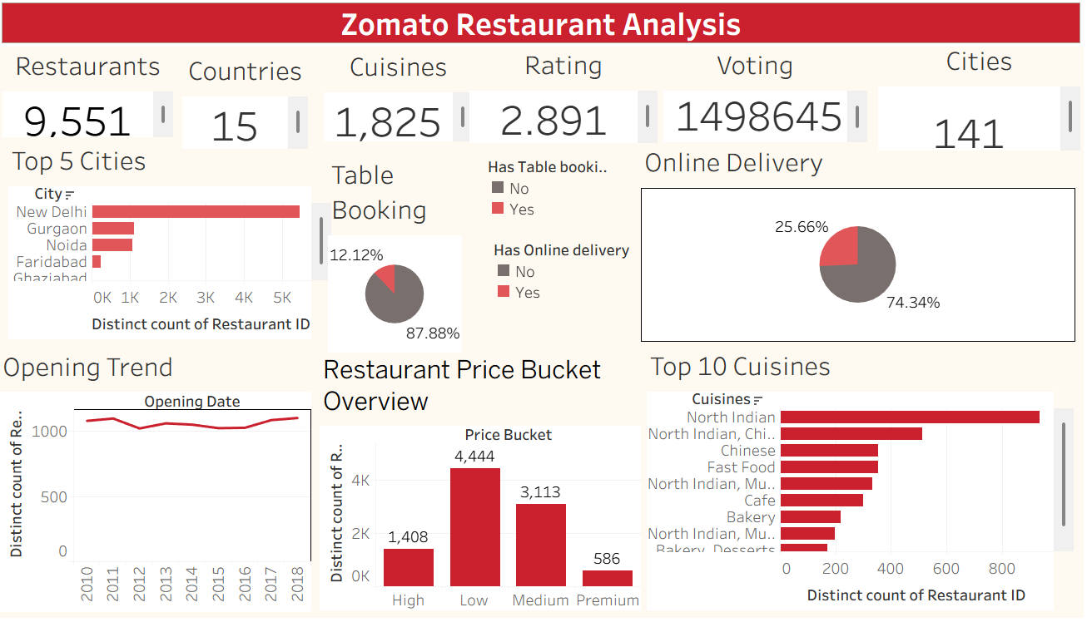
Tableau Dashboard

Slide 18
Cross-Platform Analysis
Excel
Data Cleaning
Pivot Tables
Dashboard Creation
SQL
Aggregations
KPI Validation
Advanced Queries
Power BI
Data Modeling
DAX Measures
Interactive Reports
Tableau
Storytelling
Advanced Visualizations
Interactive Dashboards

Slide 19
Business Insights
Most restaurants are concentrated in a few major cities.
Restaurants with table booking generally have higher ratings.
Online delivery services increase customer engagement.
Certain cuisines dominate restaurant preferences.
Higher votes often correlate with higher ratings.
Cost for two varies significantly across countries.

Slide 20
Key Takeaways
Zomato data provides valuable restaurant and customer insights.
SQL helps validate and analyze restaurant performance.
Excel supports quick exploratory analysis.
Tableau creates effective visual storytelling.
Power BI enables interactive business reporting.
Combining all tools demonstrates a complete analytics workflow.

Slide 21
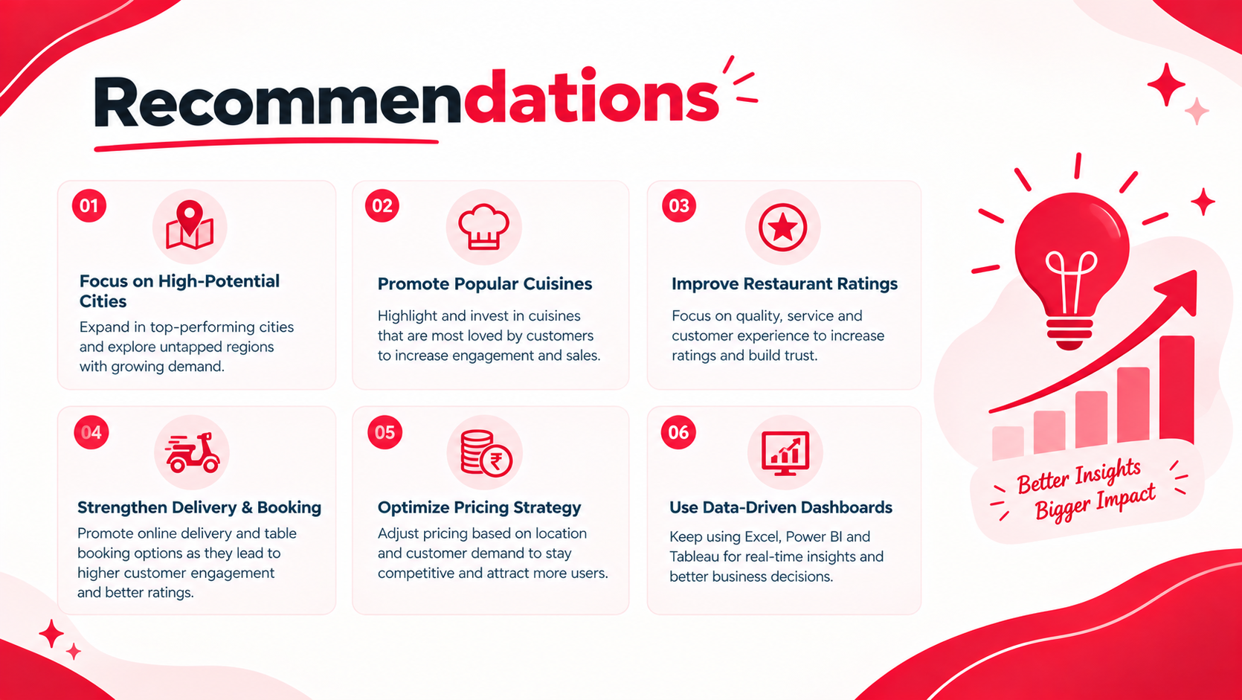

Slide 22
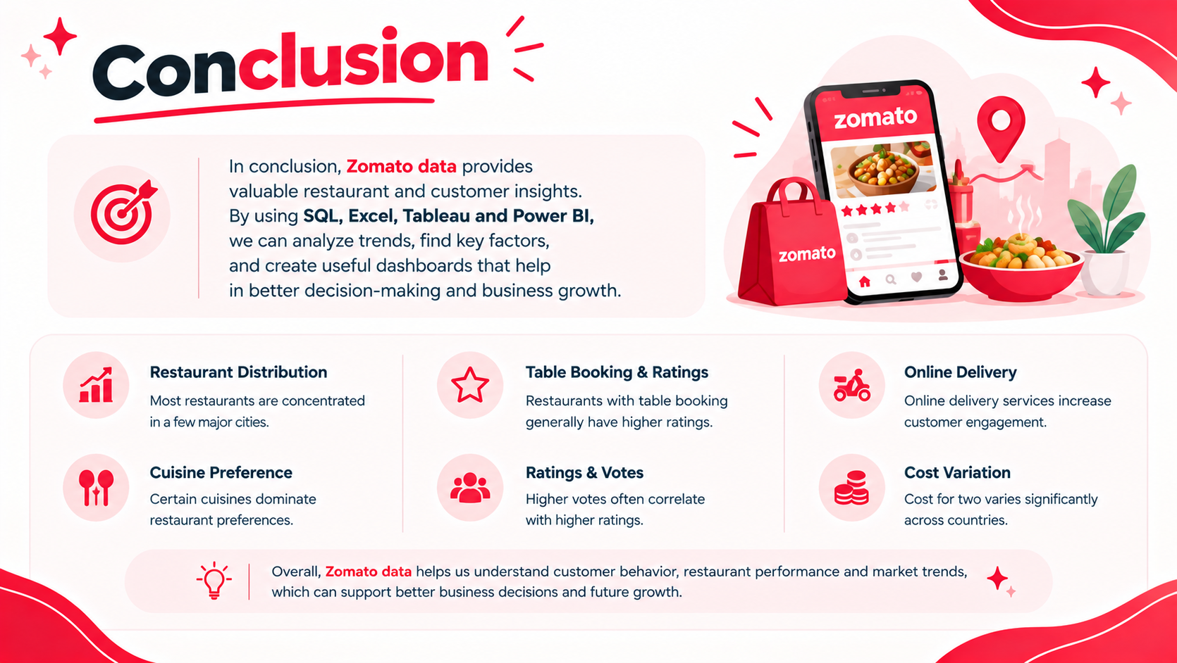

Slide 23


